Slide 1
Chapter 9 Multiple Core Computers

Slide 2
Topics
9.1 Multiple core organization
9.2 Graphics Processing Unit (GPU) design
9.3 Usage of GPU as a co-processor

Slide 3
9.1 Multiple core organization
A multiple core or multi-core organization is one that combines two or more independent processors into a single package, often a single integrated circuit (IC).
A dual-core device contains two independent microprocessors.
In general, multi-core organization allow a computing device to exhibit some form of thread-level parallelism (TLP) without including multiple microprocessors in separate physical packages.

Slide 4
Major Technology Providers
The latest versions of many architectures use multi-core, including PA-RISC (PA-8800), IBM POWER (POWER7), SPARC (UltraSPARC IV), and various processors from Intel and AMD.
There is some controversy as to whether multiple cores on a chip is the same thing as multiple processors. Major technology providers are divided on this issue.
IBM considers its dual-core POWER4 and POWER5 to be two processors, just packaged together.
Sun Microsystems, in contrast, considers its UltraSPARC IV to be a multi-threaded rather than multi-processor chip.
Intel considers their multi-core designs to be a single processor.
This is not an idle debate, because software is often more expensive when licensed for more processors.

Slide 5
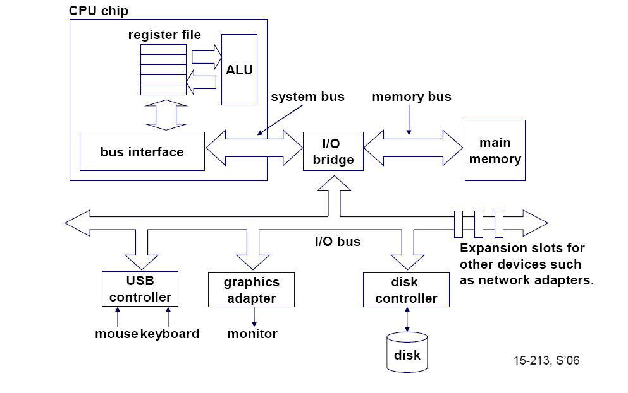
Single-core computer

Slide 6
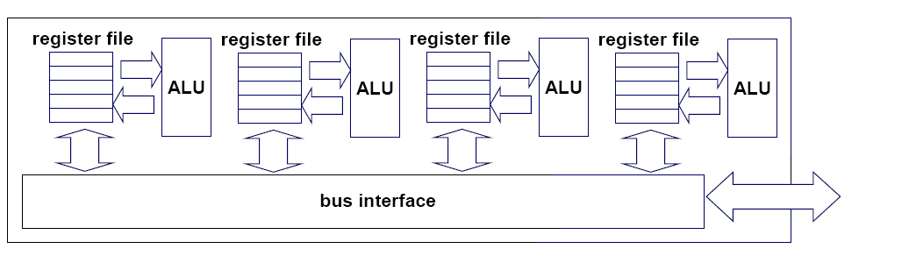
Multi-core architectures
Replicate multiple processor cores on a single die.
Core 1
Core 2
Core 3
Core 4
Multi-core CPU chip

Slide 7
Multi-core CPU chip
The cores fit on a single processor socket
Also called CMP (Chip Multi-Processor)
core
1
core
2
core
3
core
4

Slide 8
The cores run in parallel
thread 1
thread 2
thread 3
thread 4
core
1
core
2
core
3
core
4

Slide 9
Within each core, threads are time-sliced (just like on a uniprocessor)
several threads
several threads
several threads
several threads
core
1
core
2
core
3
core
4

Slide 10
Interaction with OS
OS perceives each core as a separate processor
OS scheduler maps threads/processes to different cores
Most major OS support multi-core today

Slide 11
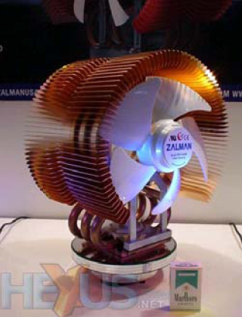
Why multi-core ?
Difficult to make single-core clock frequencies even higher
Many new applications are
multithreaded
General trend in computer
architecture (shift towards
more parallelism)

Slide 12
Instruction-level parallelism
Parallelism at the machine-instruction level
The processor can re-order, pipeline instructions, split them into microinstructions, do aggressive branch prediction, etc.
Instruction-level parallelism enabled rapid increases in processor speeds over the last 15 years

Slide 13
Thread-level parallelism (TLP)
This is parallelism on a more coarser scale
Server can serve each client in a separate thread (Web server, database server)
A computer game can do AI, graphics, and physics in three separate threads
Single-core superscalar processors cannot fully exploit TLP
Multi-core architectures are the next step in processor evolution: explicitly exploiting TLP

Slide 14
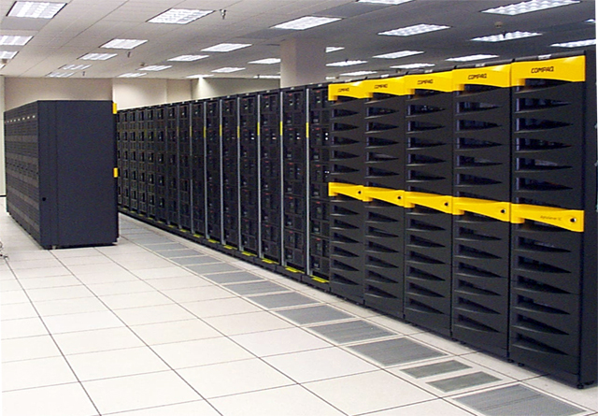
General context: Multiprocessors
Multiprocessor is any computer with several processors
SIMD
Single instruction, multiple data
Modern graphics cards
MIMD
Multiple instructions, multiple data
Lemieux cluster, Pittsburgh supercomputing center

Slide 15
Multiprocessor memory types
Shared memory: In this model, there is one (large) common shared memory for all processors
Distributed memory: In this model, each processor has its own (small) local memory, and its content is not replicated anywhere else

Slide 16
Multi-core processor is a special kind of a multiprocessor: All processors are on the same chip
Multi-core processors are MIMD: Different cores execute different threads (Multiple Instructions), operating on different parts of memory (Multiple Data).
Multi-core is a shared memory multiprocessor: All cores share the same memory

Slide 17
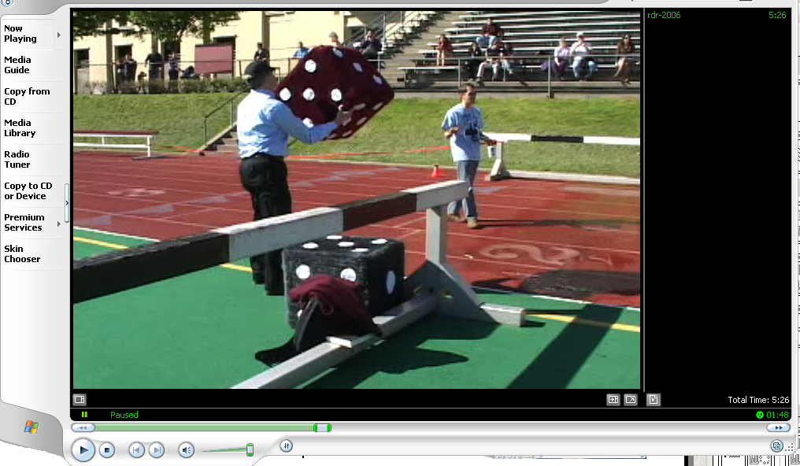
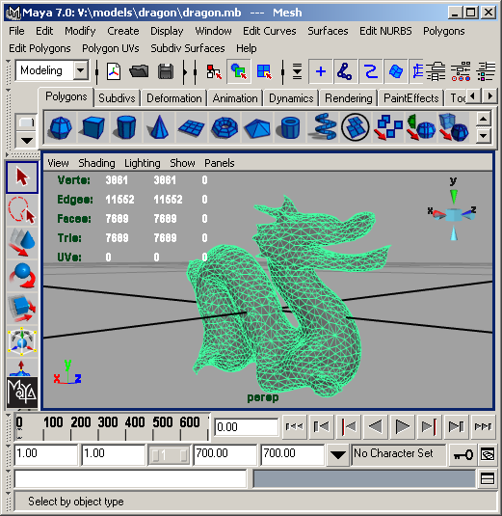
What applications benefit from multi-core?
Database servers
Web servers (Web commerce)
Telecommuncation markets: 6WINDGate (datapath and control plane)
Multimedia applications
Scientific applications, CAD/CAM
In general, applications with Thread-level parallelism (as opposed to instruction-level parallelism)
Each can run on its own core

Slide 18
More examples
Editing a photo while recording a TV show through a digital video recorder
Downloading software while running an anti-virus program
“Anything that can be threaded today will map efficiently to multi-core”
BUT: some applications difficult to parallelize

Slide 19
9.2 Graphics Processing Unit (GPU) design
GPU is a graphical processing unit which enables running high definitions graphics on Personal Computers.
Similar to Central Processing Unit (CPU), GPU is a single-chip processor.
The GPU has hundreds of cores as compared to the 4 or 8 in the latest CPUs.
The primary job of the GPU is to compute 3D functions.
GPU parallelism is similar to multicore parallelism

Slide 20
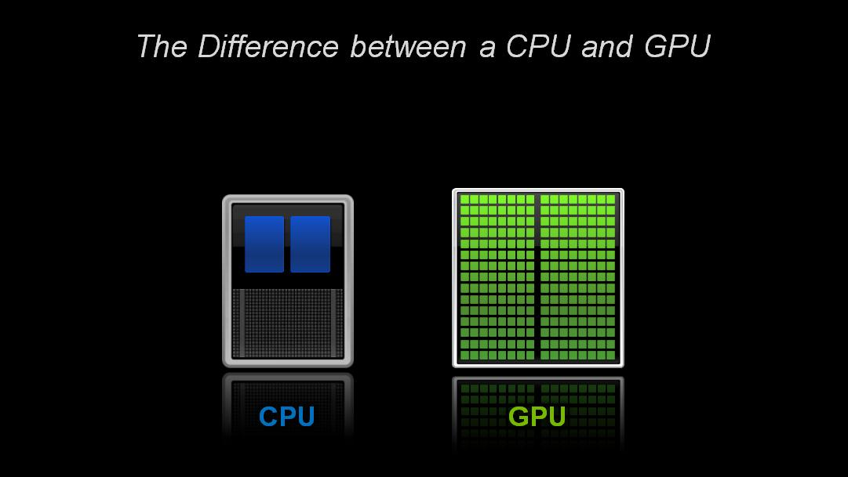
Parallelism

Slide 21
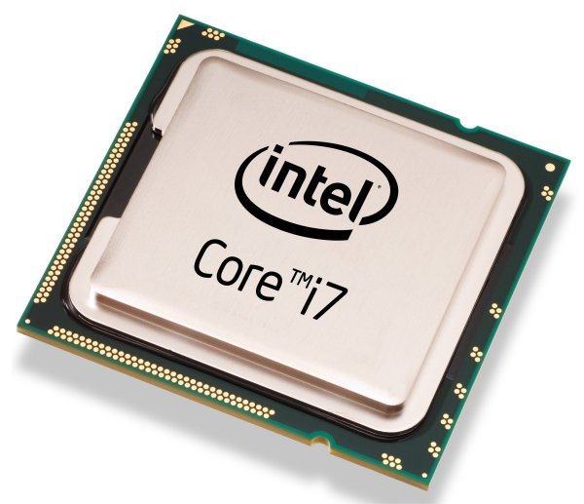
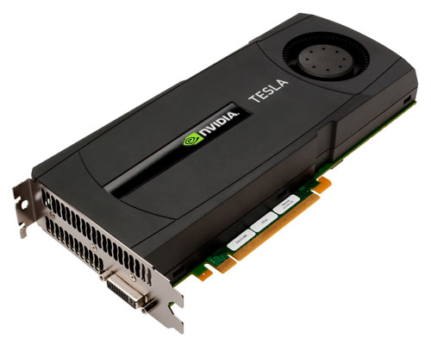
Heterogeneous Computing
Host: the CPU and its memory
Device: the GPU and its memory

Slide 22
GPU vs CPU
A GPU is tailored for highly parallel operation while a CPU executes programs serially
For this reason, GPUs have many parallel execution units and higher transistor counts, while CPUs have few execution units and higher clockspeeds
A GPU is for the most part deterministic in its operation (though this is quickly changing)
GPUs have much deeper pipelines (several thousand stages vs 10-20 for CPUs)
GPUs have significantly faster and more advanced memory interfaces as they need to shift around a lot more data than CPUs

Slide 23
GPU Architectures
Processing is highly data-parallel
GPUs are highly multithreaded
Use thread switching to hide memory latency
Less reliance on multi-level caches
Graphics memory is wide and high-bandwidth
Trend toward general purpose GPUs
Heterogeneous CPU/GPU systems
CPU for sequential code, GPU for parallel code
Programming languages/APIs
DirectX, OpenGL
Compute Unified Device Architecture (CUDA)

Slide 24
The GPU pipeline
The GPU receives geometry information from the CPU as an input and provides a picture as an output
Let’s see how that happens
host
interface
vertex
processing
triangle
setup
pixel
processing
memory
interface

Slide 25
Host Interface
The host interface is the communication bridge between the CPU and the GPU
It receives commands from the CPU and also pulls geometry information from system memory
It outputs a stream of vertices in object space with all their associated information (normals, texture coordinates, per vertex color etc)
host
interface
vertex
processing
triangle
setup
pixel
processing
memory
interface

Slide 26
Vertex Processing
The vertex processing stage receives vertices from the host interface in object space and outputs them in screen space
This may be a simple linear transformation, or a complex operation involving morphing effects
Normals, texcoords etc are also transformed
No new vertices are created in this stage, and no vertices are discarded (input/output has 1:1 mapping)
host
interface
vertex
processing
triangle
setup
pixel
processing
memory
interface

Slide 27
Triangle setup
In this stage geometry information becomes raster information (screen space geometry is the input, pixels are the output)
Prior to rasterization, triangles that are backfacing or are located outside the viewing frustrum are rejected
Some GPUs also do some hidden surface removal at this stage
host
interface
vertex
processing
triangle
setup
pixel
processing
memory
interface

Slide 28
Triangle Setup (cont)
A fragment is generated if and only if its center is inside the triangle
Every fragment generated has its attributes computed to be the perspective correct interpolation of the three vertices that make up the triangle
host
interface
vertex
processing
triangle
setup
pixel
processing
memory
interface

Slide 29
Fragment Processing
Each fragment provided by triangle setup is fed into fragment processing as a set of attributes (position, normal, texcoord etc), which are used to compute the final color for this pixel
The computations taking place here include texture mapping and math operations
Typically the bottleneck in modern applications
host
interface
vertex
processing
triangle
setup
pixel
processing
memory
interface

Slide 30
Memory Interface
Fragment colors provided by the previous stage are written to the framebuffer
Used to be the biggest bottleneck before fragment processing took over
Before the final write occurs, some fragments are rejected by the zbuffer, stencil and alpha tests
On modern GPUs, z and color are compressed to reduce framebuffer bandwidth (but not size)
host
interface
vertex
processing
triangle
setup
pixel
processing
memory
interface

Slide 31
Programmability in the GPU
Vertex and fragment processing, and now triangle set-up, are programmable
The programmer can write programs that are executed for every vertex as well as for every fragment
This allows fully customizable geometry and shading effects that go well beyond the generic look and feel of older 3D applications
host
interface
vertex
processing
triangle
setup
pixel
processing
memory
interface

Slide 32
Diagram of a modern GPU
Input from CPU
Host interface
Vertex processing
Triangle setup
Pixel processing
Memory Interface
64bits to
memory
64bits to
memory
64bits to
memory
64bits to
memory

Slide 33
CPU/GPU interaction
The CPU and GPU inside the PC work in parallel with each other
There are two “threads” going on, one for the CPU and one for the GPU, which communicate through a command buffer:
GPU reads commands from here
Pending GPU commands
CPU writes commands here

Slide 34
CPU/GPU interaction (cont)
If this command buffer is drained empty, we are CPU limited and the GPU will spin around waiting for new input. All the GPU power in the universe isn’t going to make your application faster!
If the command buffer fills up, the CPU will spin around waiting for the GPU to consume it, and we are effectively GPU limited

Slide 35
CPU/GPU interaction (cont)
Another important point to consider is that programs that use the GPU do not follow the traditional sequential execution model
In the CPU program below, the object is not drawn after statement A and before statement B:
Instead, all the API call does, is to add the command to draw the object to the GPU command buffer
Statement A
API call to draw object
Statement B

Slide 36
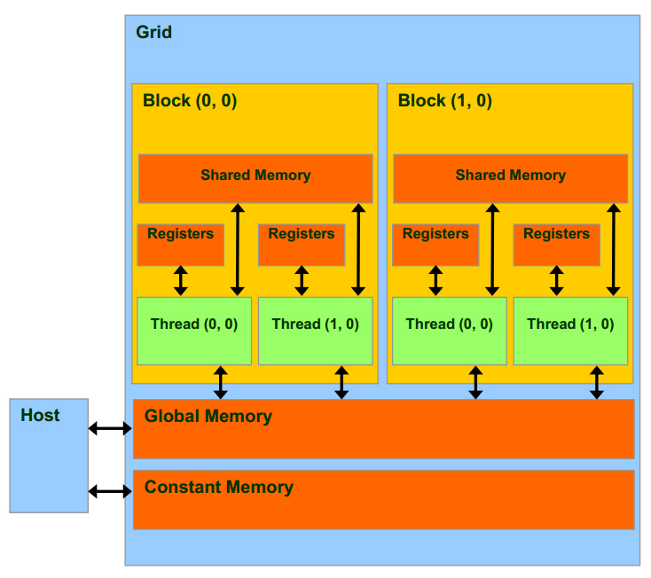
Grids, Blocks, and Threads

Slide 37
CUDA Memory
Faster, per-block
Fastest, per-thread
Slower, global
Read-only, cached

Slide 38
Graphics Hardware Abstraction
OpenGL and DirectX provide an abstraction of the hardware.

Slide 39
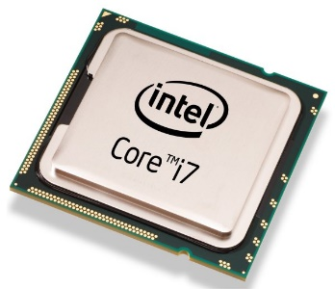

Programming using CUDA
Compute Unified Device Architecture
do_something_on_host();
kernel<<<nBlk, nTid>>>(args);
cudaDeviceSynchronize();
do_something_else_on_host();
…
Highly parallel

Slide 40
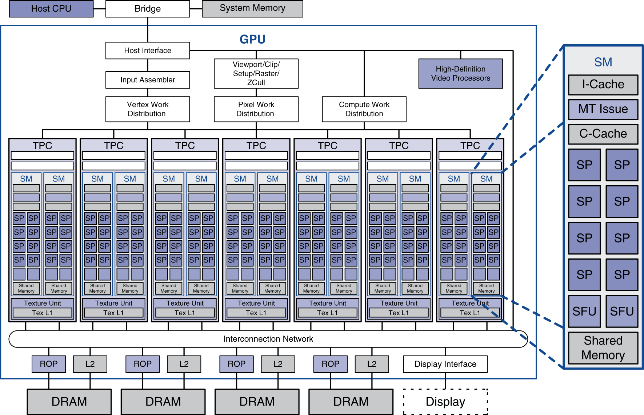
Example: NVIDIA Tesla
Streaming multiprocessor
8 × Streaming processors

Slide 41
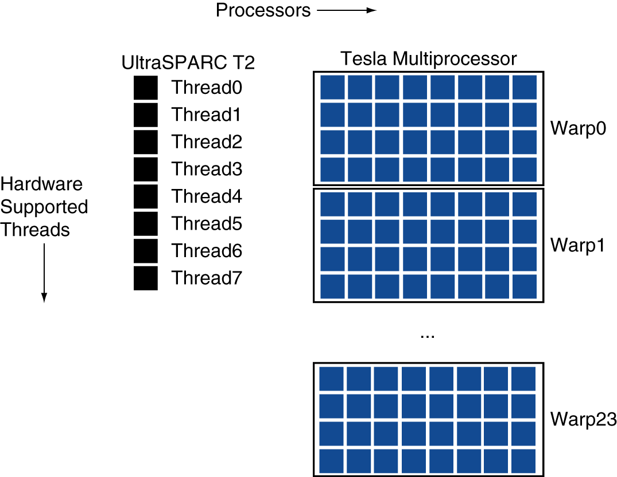
Example: NVIDIA Tesla
Streaming Processors
Single-precision FP and integer units
Each SP is fine-grained multithreaded
Warp: group of 32 threads
Executed in parallel, SIMD style
8 SPs × 4 clock cycles
Hardware contexts for 24 warps
Registers, PCs, …

Slide 42
Modern GPU has more ALU’s

Slide 43
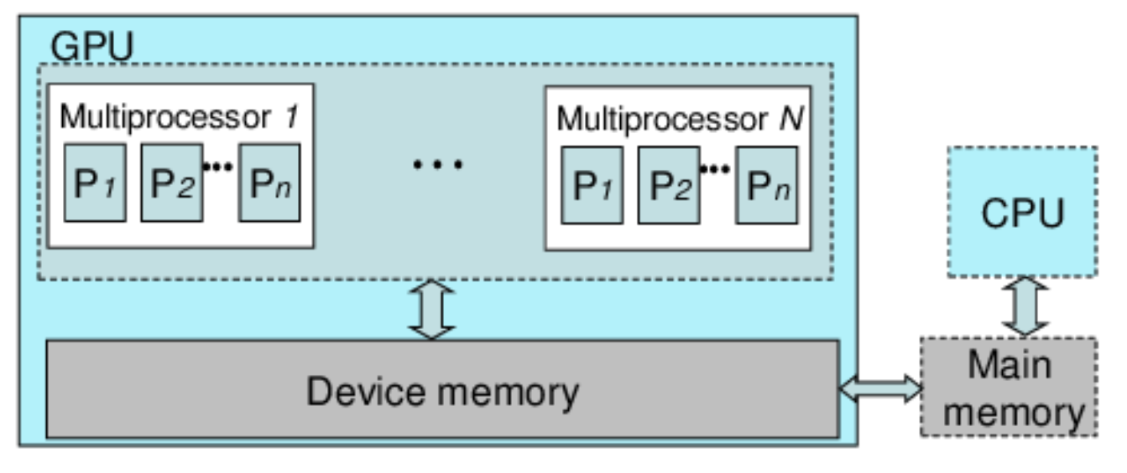
9.3 Usage of GPU as a co-processor
The GPU architecture model. The GPU is a coprocessor to the CPU.
It consists of multiple SIMD multiprocessors, and has a large amount of device memory.
This model is applicable to both NVIDIA's CUDA and AMD's CTM .

